Slide 1









CANCER REGISTRY SYSTEM FOR BANGLADESH

Slide 2
PRESENTED BY
Md. Tareq Hassan
18301124
Rahmat Ullah Sujan
18201081
Tushar Imran Sarkar
18201060
Gazi Sharin Mostafiz
18301123
Mohammad Jonayed Talukder
18301186

Slide 3
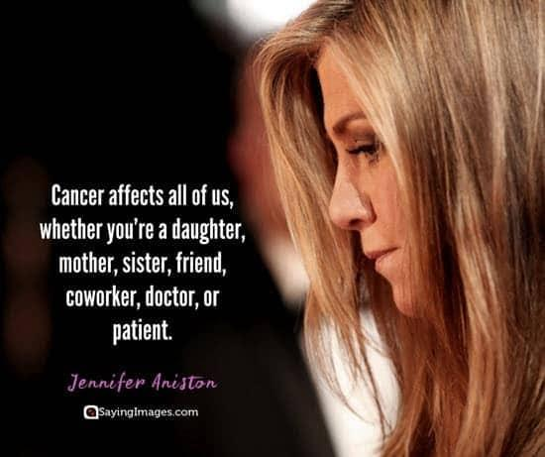

Slide 4
RESEARCH OBJECTIVES
To introduce a well-developed cancer registry system for storing cancer data.
Cost effective to make it affordable for them.
User will get all types of information regarding cancer.
Hassle free and user-friendly digital system which will reduce people suffering.
To introduce an easily manageable and convenient ID card containing unique QR code used as a portal for storing and retrieving patient’s data.
To ensure continuous care to patients and provide timely information through dynamic recommendations.
Gathering of information about the prevalence and trends of risk variables.
Enough information for research purpose
Assisting in the detection of cancer in its early stages

Slide 5
HISTORY
John Graunt inventor of data registry system
Three types of cancer registries
population based registry
hospital based registry
special based registry
More than 250 population-based cancer registries among 60 countries
No central cancer registry in Bangladesh

Slide 6
RESEARCH PROBLEM
No central registry system available for capturing the whole picture of the treatment process of cancer
Sometimes the patients are not willing to share their personal information with others
Unaware of cancer registry system

Slide 7
RESEARCH CONTRIBUTION
User-friendly interface
Card based on QR code system
General format for any type of blood report
Searchability option
Ensure cost effectiveness

Slide 8
Related Works
OWise - Breast Cancer and Support (2021)
Store daily entries of patients
Uploading individual treatment information
Can include voicemails, voice recordings and pictures
doctors have access to patient information.
Central Cancer Registry (CCR) (2019)
Oncologists can utilise stored data
Doctors can make patient profiles, write prescriptions and view treatment histories
Doctors can stage the cancer using the TNM staging system (cType and pType)
Cancer, Cancer Control and Bangladesh (2012)
Demographic information of cancer patients are used for statistical analysis
Global Cancer Registry Software (2021)
Patient care, medical research, clinical investigations and open database access
Kentucky Cancer Registry (2019)
User friendly and dynamic data input system
Can save incomplete abstractions for later completion

Slide 9
METHODOLOGY
Conducting the Survey
Following those method:
1. Survey Questionnaire Design
2. Approaching the Target Audiences
3. Analyzing the Survey Result

Slide 10
METHODOLOGY
Conducting the Survey
Survey Questionnaire Design
Divided the target audience into two categories.
Standard Guidelines
Using google forms
Conducted Informal Conversation.

Slide 11
METHODOLOGY
Conducting the Survey
Approaching the Target Audiences
Interview with the doctor.
Interview with the patient
Analyzing the Survey Result
Generate variety of summarized diagram.
Design the Prototype
Notes:
Talk with doctor and patient and we took interview in the advance hospital with their permission and take some patient interview.

Slide 12
METHODOLOGY
Conducting the Survey
Analyzing the Survey Result
Generate variety of summarized diagram.
Design the Prototype
Notes:
Taking informal interview with the patient those who cannot fillup the google form. We’re

Slide 13
METHODOLOGY
Designing the Prototype
Doctor’s Page
Scan QR code
The scan QR code option the camera will be functional and capture QR code
Patient’s Page
Records of the patient
several panels for showing distinctive data and records of patients.
Notes:
Doctor page font a qr thakbe and check krte parbe

Slide 14
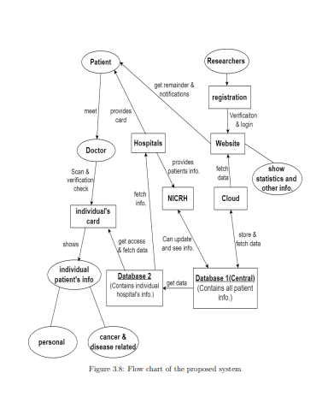
METHODOLOGY
Convert Image to Text & Store Data
Optical Character Recognition (OCR) is the process that converts an image of text into a machine-readable text format.
Find Necessary Data
OCR process
AWS Textract
Database
Two databases are used
Central Database
One for Individual Hospital Database

Slide 15
Analysis on experiment and survey results
Types of analysis:
Quantitative analysis
Qualitative analysis
Use Quantitative analysis for survey
The answers of the survey questions are straight forward

Slide 16
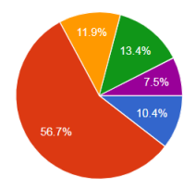
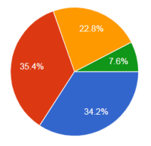
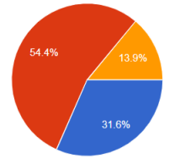
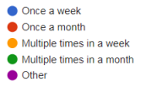
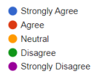
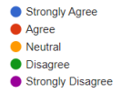
Outcome from the patient interview

Slide 17
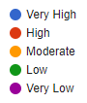
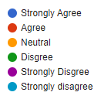
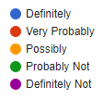

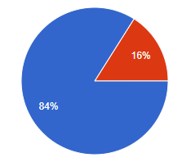
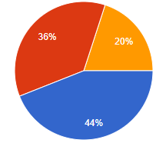
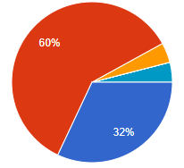
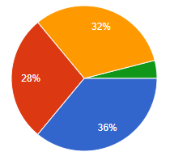
Outcome from the doctor interview
Internet accessibility in chamber Numbers of patients need to maintain Opinion on central cancer registry system Opinion on logging in QR code

Slide 18
Data analysis from survey
Chi-Square test
Idea about card-based registry system VS opinion on using ID card for easier accessibility
Opinion on the difficulty of managing hard copies of report VS a system storing all diagnosis data is helpful
Idea about card-based registry system VS opinion on using a patient’s ID card for easier accessibility

Slide 19
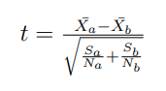
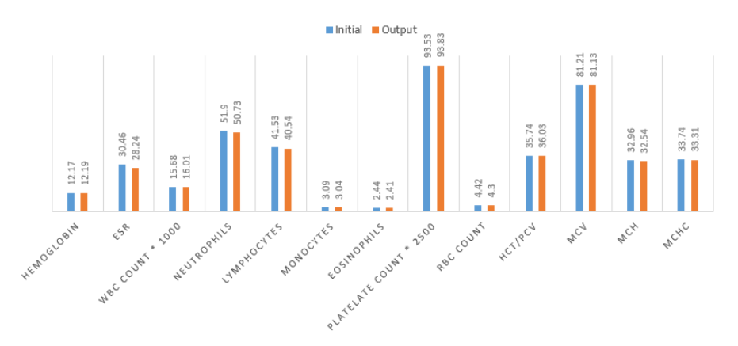
Analysis on system output
Initial comparison
Percentage difference
Average accuracy
T-test (t)
Precision
Average Difference between two data-sets

Slide 20
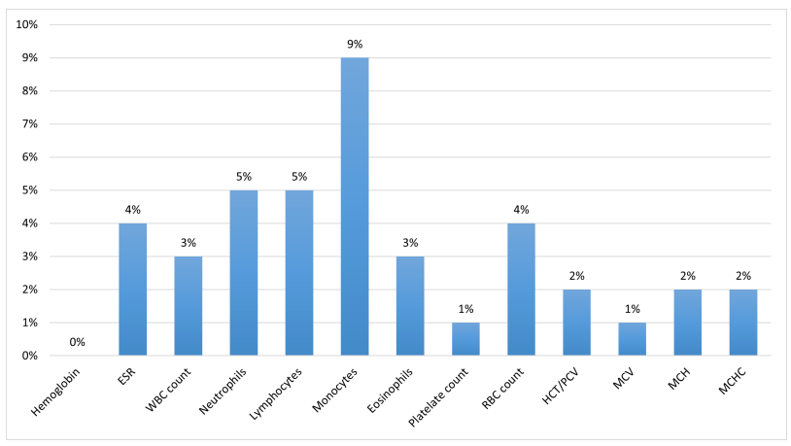
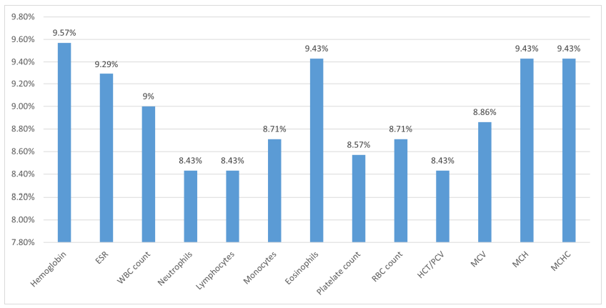
Closeness Between Two Datasets in Percentage
(Percentage difference)
Exactness Between Two Datasets in Percentage
(Average accuracy)

Slide 21
Estimated cost of our proposed system
Total user = 50000 persons
Max file uploaded by each user = 2 files (Overall size = 1MB)
Maintenance, storage fee
Total monthly cost = 501.05 $ (Approximately = 500 $)

Slide 22
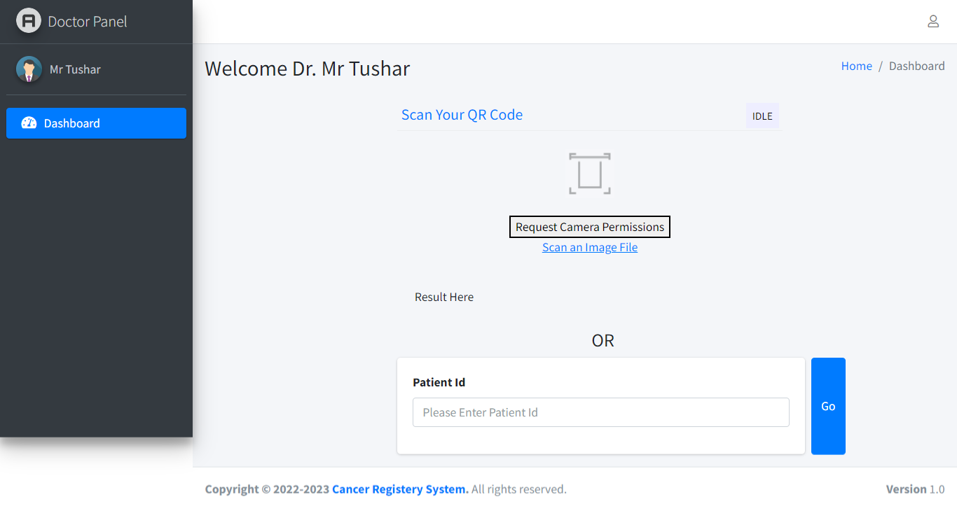
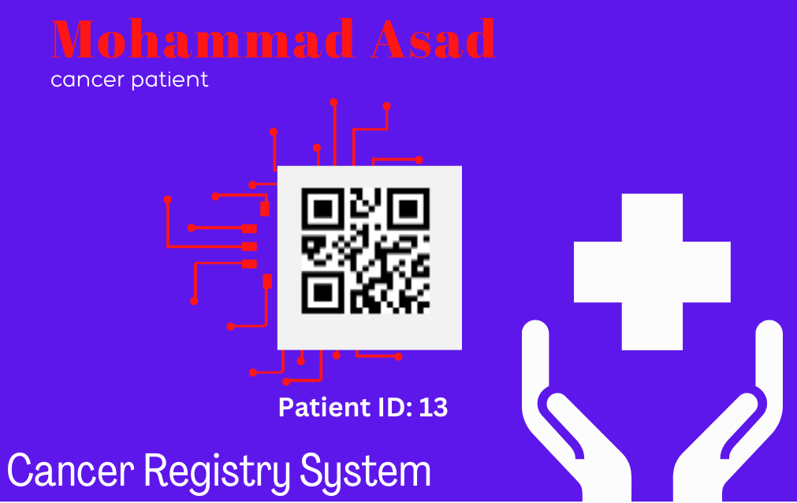
PROPOSED MODEL
Prototype
Doctor Panel
Accessibility to patient page by QR code scan or entering patient ID

Slide 23
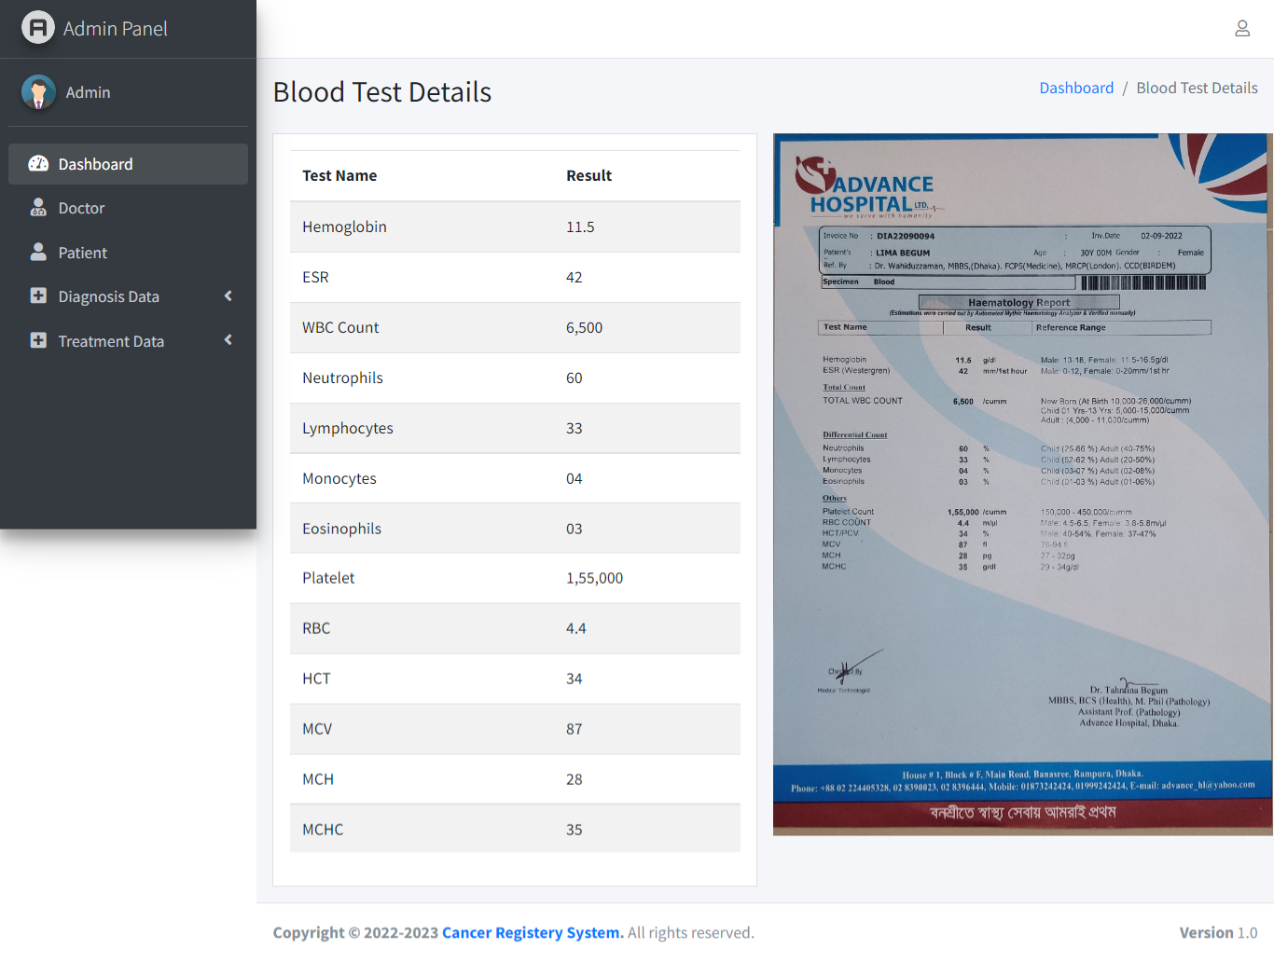
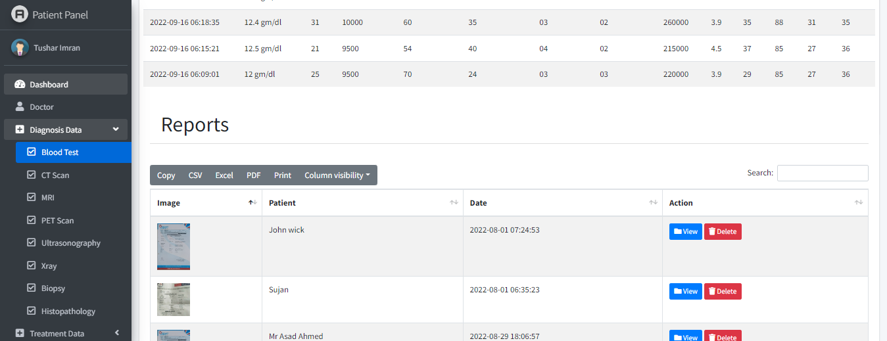
PROPOSED MODEL
Prototype
Doctor Panel
View diagnosis and treatment reports.
View blood tests in a general format.

Slide 24
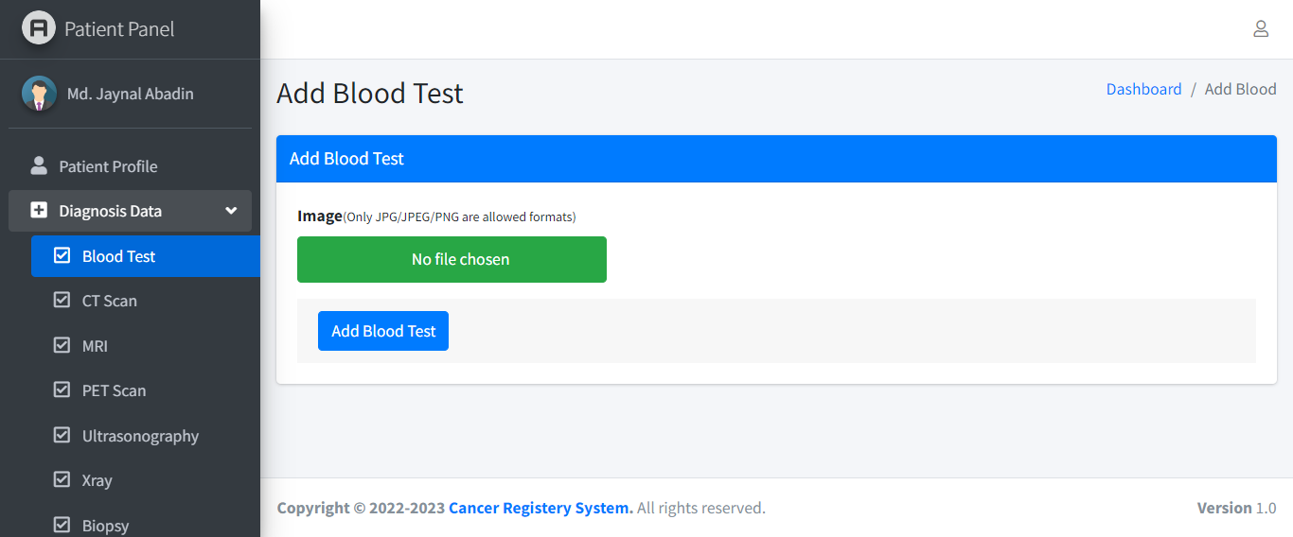
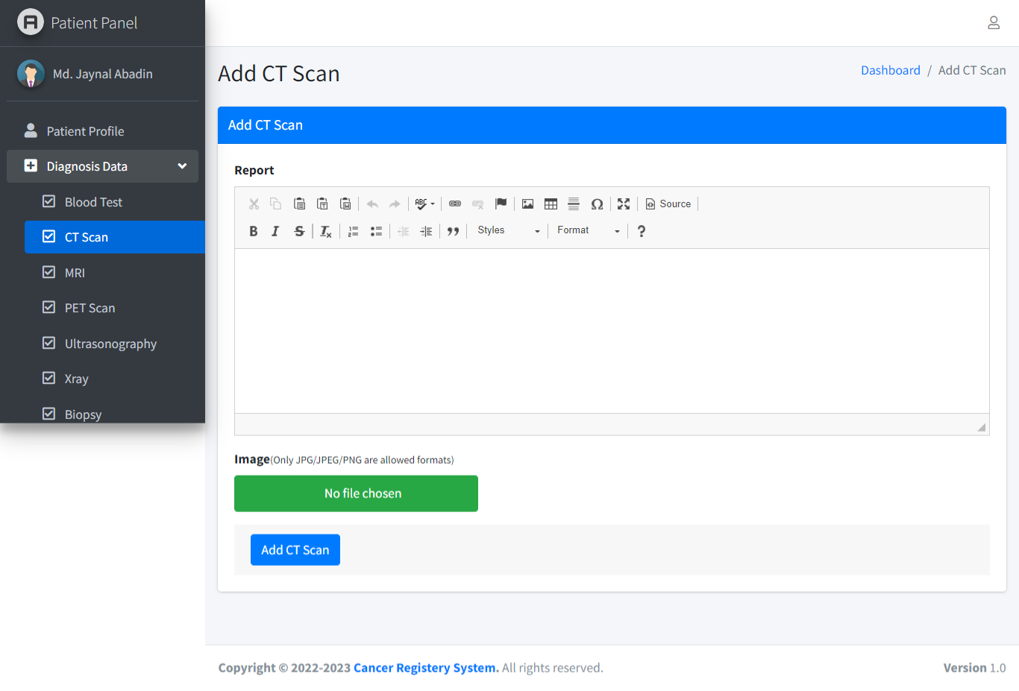
PROPOSED MODEL
Prototype
Doctor Panel
Add reports if necessary

Slide 25
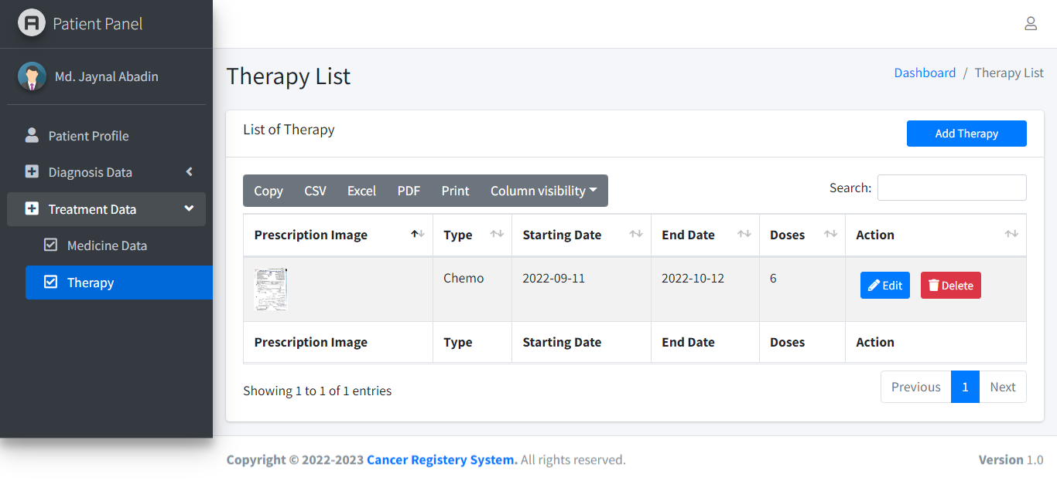
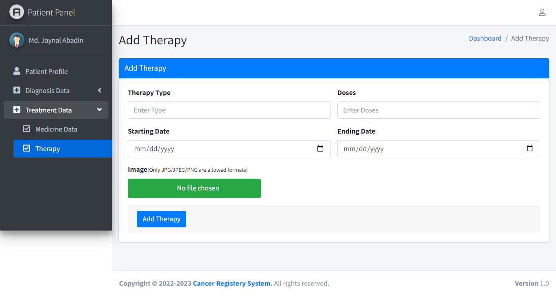
PROPOSED MODEL
Prototype
Doctor Panel
Add treatment data

Slide 26
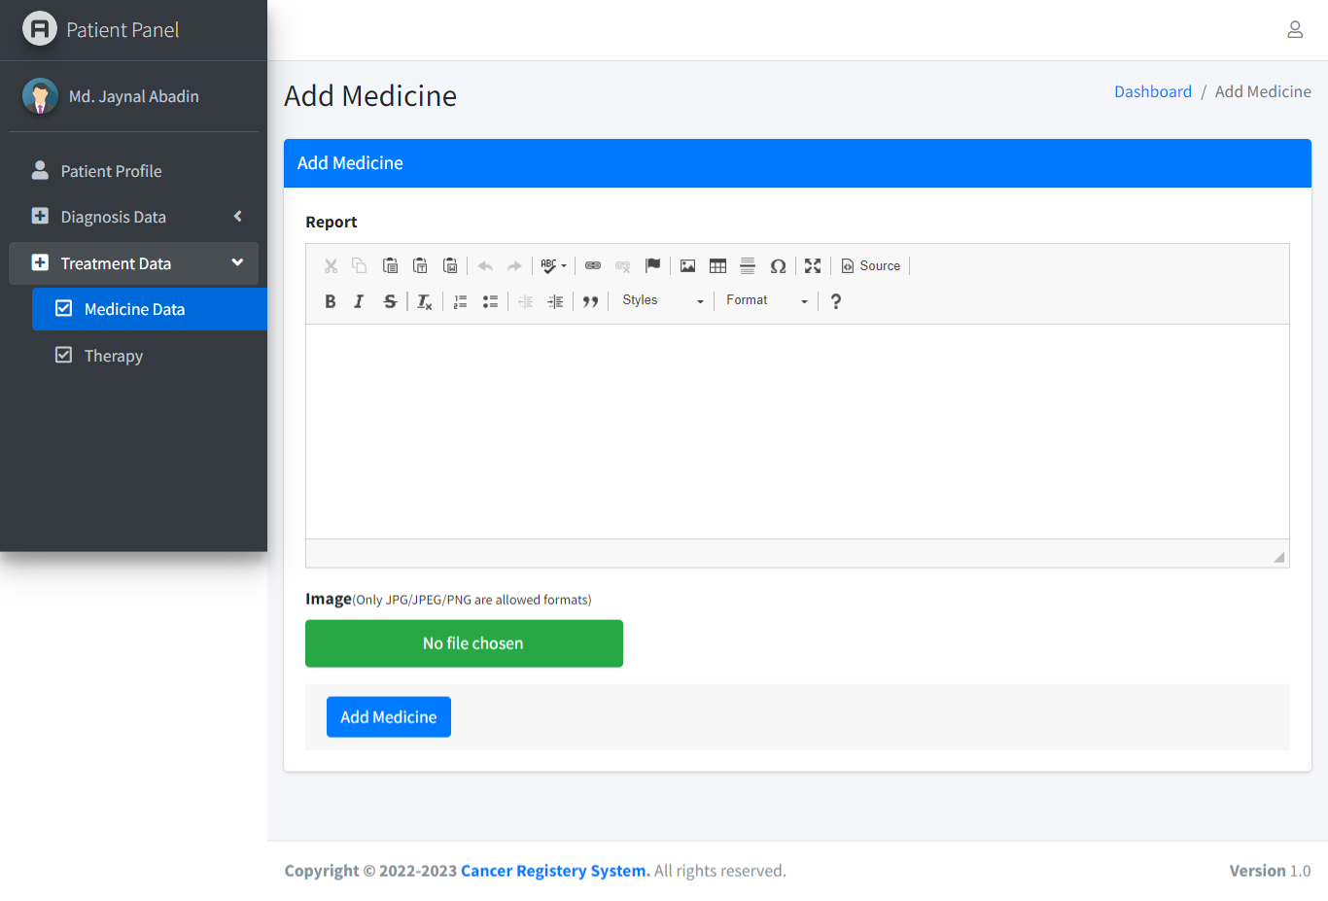
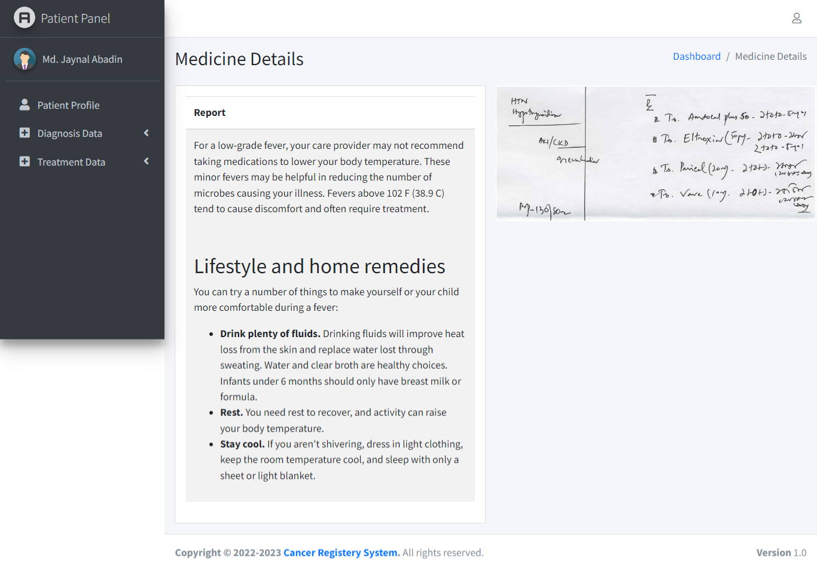
PROPOSED MODEL
Prototype
Doctor Panel
Add treatment data

Slide 27
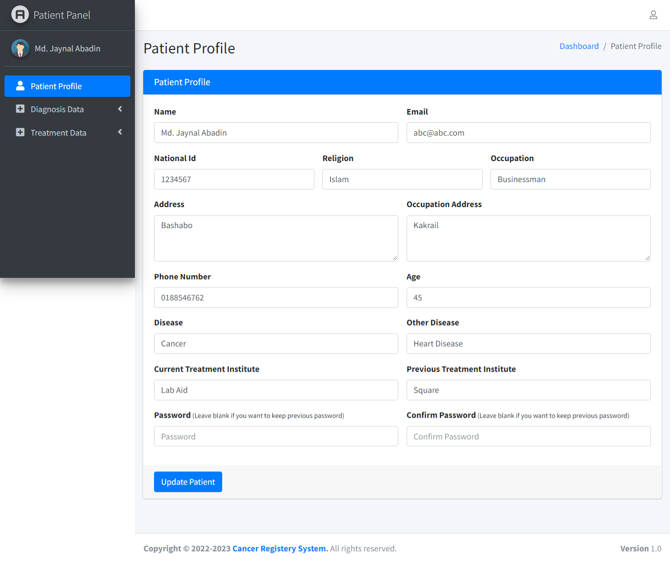
PROPOSED MODEL
Prototype
Patient Panel:
View and add diagnosis data

Slide 28
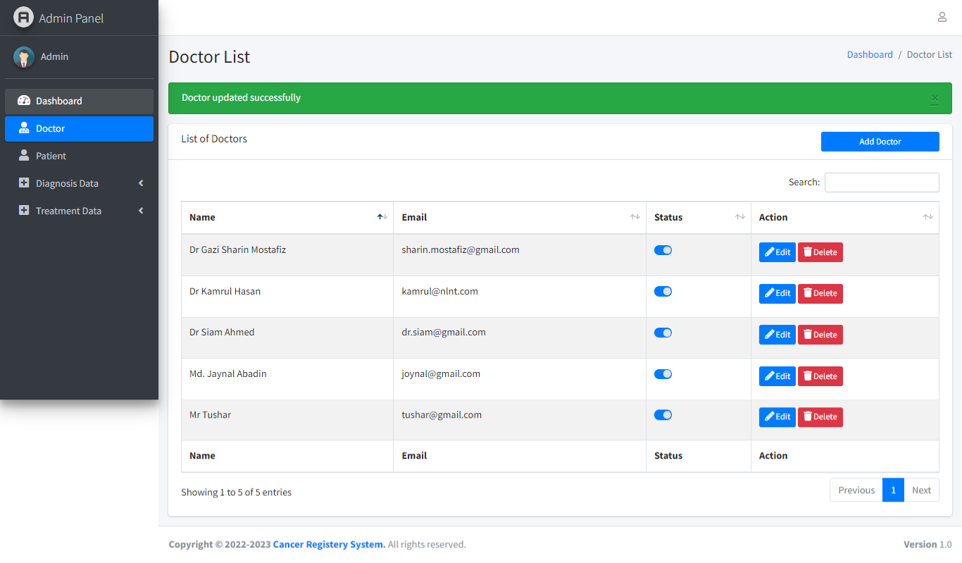
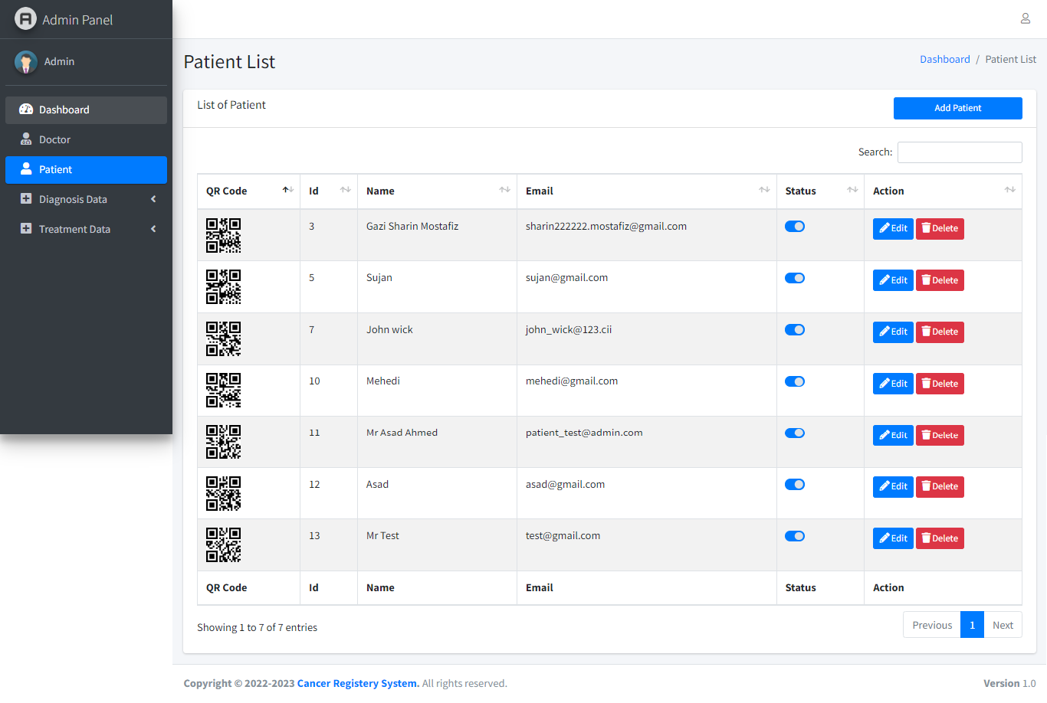
PROPOSED MODEL
Prototype
Admin Panel:
Add Doctor and Patient
Add reports if required

Slide 29
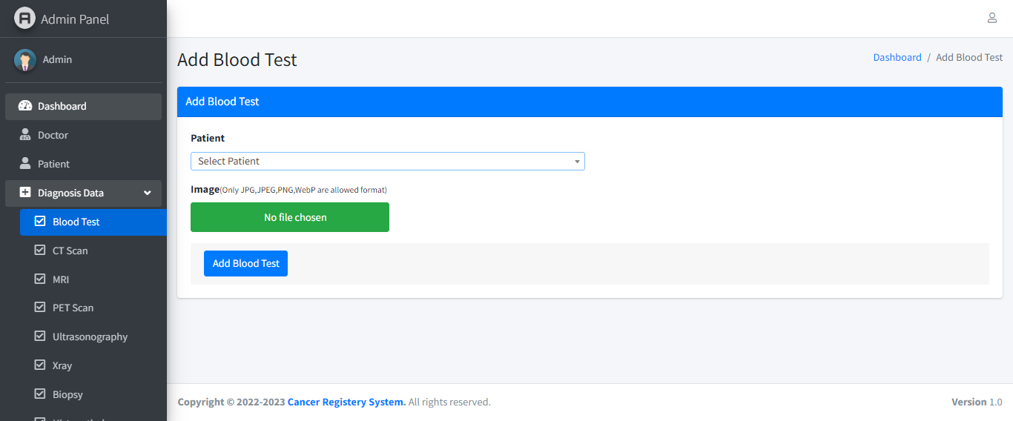
PROPOSED MODEL
Prototype
Admin Panel:
Add Doctor and Patient
Add reports if required

Slide 30
IMPLEMENTATION MODEL
Prototype
Framework : Laravel
Server : XAMPP
Database: MySQL
API : Textract API of AWS

Slide 31
COMPARISON WITH EXISTING WORK
Existing Work
Proposed One
Stores demographic data with Treatment and Diagnosis History.
Unique ID containing QR code.
Uses OCR to extract and store data.
Only stores demographic data (DMCH, NIRCH, Square Hospital.)
No individual unique ID system.
No OCR process to store data.

Slide 32
LIMITATIONS AND FUTURE WORK
Limitations
Future Work
OCR of blood report only
Low picture resolution results less accuracy.
There is a plenty of room to extend the study. We plan to explore in future.
Implementing OCR in other tests such as MRI, CT-Scan & Making accuracy 100%.
Launch Mobile App and a portable version of application to use it in offline.

Slide 33
CONCLUSION
As a developing country, like ours it is must to have a Global Cancer Registry System for maintaining the large number of patients.
It will monitor growth and providing accurate data on the incidence, prevalence, and mortality of cancer patients.
Cancer registry system which will reduce the suffering of both doctor and patient.
Our cancer registry is nothing but a leap towards that cherished goal.

Slide 34
Thank You

Slide 35
REFERENCES :
S. Roopa and M. Rani, “Questionnaire designing for a survey,” Journal of Indian Orthodontic Society, vol. 46, no. 4 suppl1, pp. 273–277, 2012.
R. Verma and J. Ali, “A-survey of feature extraction and classification techniques in ocr systems,” International Journal of Computer Applications & Information Technology, vol. 1, no. 3, pp. 1–3, 2012.
S. A. Hussain and R. Sullivan, “Cancer control in bangladesh,” Japanese journal of clinical oncology, vol. 43, no. 12, pp. 1159–1169, 2013.
Module 1: Cancer Registry, howpublished = https : / / www . tn . gov / health / health- program- areas/ tcr/ cancer-reporting- facility- training/ module1.html, note = Accessed: 2021-04-14.
M. P. Robillard and R. DeLine, “A field study of api learning obstacles,” Empirical Software Engineering, vol. 16, no. 6, pp. 703–732, 2011.

